Slide 1
Windows System Infrastructure and SQL Server Security Policy
CIS 483 – Database Security
Computer Information Systems
University of Louisville
Ghiyoung Im, PhD

Slide 2
Agenda
Integrating with Enterprise Authentication Systems
Developing Windows Server-Level Security Policies
Developing a Secure Communication Policy
Defining SQL Server Security Monitoring Standards
Lab A: Designing a SQL Server Systems Infrastructure Security Policy
Lab B: Validating a Systems Infrastructure Security Policy

Slide 3
Considerations for Determining the Enterprise Authentication Method Implementing Server-Level Security with Active Directory Guidelines for Implementing a Server-Level Security Policy Security Impact on High-Availability Solutions Best Practices for Integrating with Enterprise Authentication Systems
Integrating with Enterprise Authentication Systems

Slide 4
Considerations for Determining the Enterprise Authentication Method
Need for Active Directory (AD)
Necessary to use Kerberos or NTLM
Configuration of Service Principal Name (SPN)
To use Kerberos, the instance of 2005 must be registered in AD
Use of TCP/IP network library
To use Kerberos, we must use TCP/IP
Impact on service uptime requirements
If SQL Server authentication is used, we do not need other services for authentication
If Windows authentication is used, we need to configure domain controllers

Slide 5
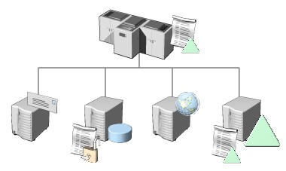
Implementing Server-Level Security with Active Directory
Need a server-level security policy for consistent management of security options
Organizational Unit (OU)
Can manage Active Directory objects (e.g., users, applications, routers) systematically
Can centrally apply server-level policies
Group Policy
Can centrally configure user and computer settings
Group policy settings can be applied to OUs

Slide 6
Guidelines for Implementing a Server-Level Security Policy
Make policies independent of Active Directory or OUs
Server-level policies should be generally applicable and include policies that are related to SQL Server
Server-level policies influence SQL Server security configuration
Use OUs to group servers
If servers have the same level of security configuration, use OUs for central management
Keep OU hierarchical levels to the minimum required
Many hierarchical levels decrease the performance of authentication

Slide 7
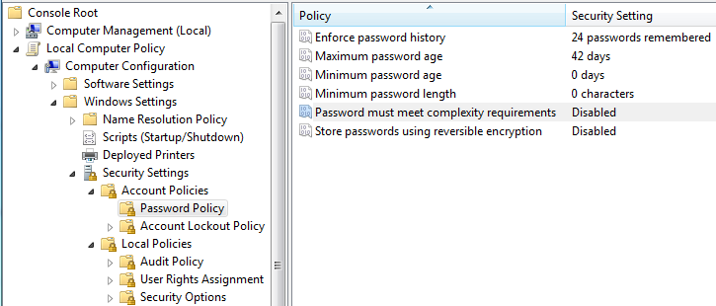
Demo: Impacts of Password Policy

Slide 8
Security Impact on High-Availability Solutions
Ensure the database is continuously operational for access
Minimize unplanned unavailability
Not acceptable in some systems (e.g., real-time, mission-critical applications)
Planned unavailability is allowed for maintenance
High-Availability options
Log Shipping
Database Mirroring
Clustering
Peer-to-peer replication

Slide 9
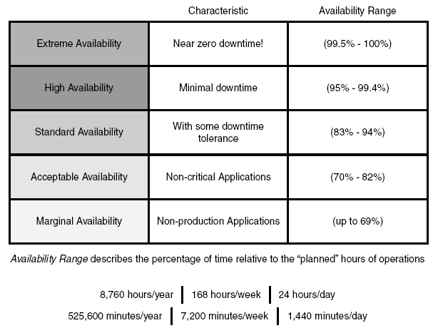
Availability Continuum
* Source: SAMS

Slide 10
Log Shipping
Scope: database
Procedure
Have a primary and secondary server
Take an exact copy of primary database and copy into secondary
Take transaction log dumps from primary and copy into secondary
Every {x minutes|hours|days}
Warm standby because of latency (not hot standby)

Slide 11
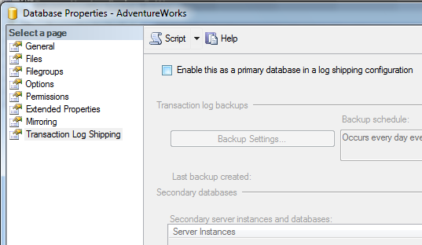
Demo: Log Shipping

Slide 12
Database Mirroring
Scope: database
Components
Principal, Mirror, and Witness servers
Witness: determine time to switch over
Can be setup across distances (log shipping also)
Uses transaction log of the principal
Copy-on-Write technology
Log shipping vs mirroring
Mirroring: faster, hot standby, latency is milliseconds
Support automatic failover (requires witness server instance)
Can automatically detect when principal is down and redirect clients

Slide 13
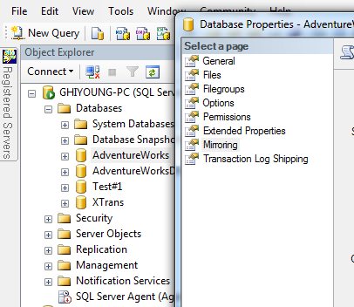
Demo: Database Mirroring

Slide 14
SQL Server Clustering (1/2)
Scope: instance
Components
Cluster: a set of two or more servers (called nodes)
Public network: users connect
Private network (heartbeat): two nodes constantly talk
External connections made to the cluster (not to node) via cluster service, and directed to active node
Provide automatic failover of resources (transparent redirection)
Log-shipping: manual failover
Mirroring without witness: manual failover

Slide 15
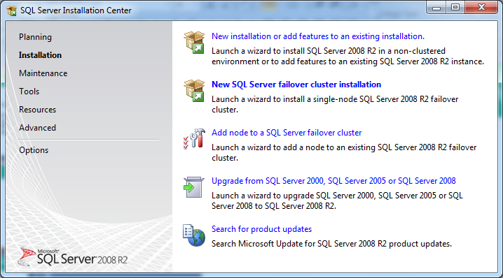
SQL Server Clustering (2/2)
Two options
Active / Passive
Active / Active
Overview

Slide 16
Replication
Data replication: “store-and-forward”
Scope: Any part of database (table, view, stored procedure); can be very granular
Transaction (only transactions as changes occur): most popular
Warm standby; used for disaster recovery
Log shipping and mirroring got faster
Types
Publisher/Subscriber
Peer-to-Peer

Slide 17
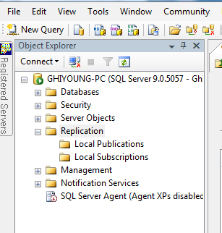
Demo: Replication

Slide 18
RAID vs Backup

Slide 19
High-Availability Security Recommendation
Mirroring
Use Kerberos if you have configured an SPN
Use certificates if SQL Server is a local service
Clustering
Use a domain account to start SQL Server
Use Kerberos against SQL Server virtual servers
Replication
Use the same user name and password on each node
Use a local nondomain account for authentication

Slide 20
Best Practices for Integrating with Enterprise Authentication Systems
Understand enterprise-wide policies and their security impact
Best Practices for integration
Use Windows authentication when possible
Integrate with Active Directory
Use OUs to implement server-level security policies
Evaluate the impact on high-availability

Slide 21
Guidelines for Developing a Password Policy Guidelines for Protecting Passwords and Applications Guidelines for Determining Service Accounts Permissions Guidelines for Identifying Required Windows Services Best Practices for Interacting with Network Firewalls Considerations for Planning the Physical Security of the Server
Developing Windows Server-Level Security Policies

Slide 22
Guidelines for Developing a Password Policy
Parameter | Guideline
Password length | More than nine characters Passwords for applications need to be longer. They are infrequently changed
Password complexity | Defined in the security policy Meet at least three: - Uppercase (A through Z) - Lowercase (a through z) - Numerals (0 through 9) - Special characters such as !, $, #, and %
Password changes | If changed frequently, attackers might be using different methods If the password is changed during password cracking, the attacker has to restart If broken and the password is changed, the attacker can’t access the account

Slide 23
Guidelines for Protecting Passwords and Applications (1/2)
Windows authentication desired - no need to send credentials over a network
Use a different password for production (or new versions) - block unauthorized access from developers
Use Microsoft Data Access Components (MDAC) to connect to SQL Server from applications
SQL Server Native Client is a recent development
Do not hardcode user name and password in the connection strings of the application
If connection strings are in files, store it after encryption

Slide 24
Guidelines for Protecting Passwords and Applications (2/2)
Password type | Guideline
Passwords for applications | Encrypt the application password Must use a different password for an application in production than the one for development
Passwords for user accounts | Use Windows authentication SQL Server level rights for user accounts

Slide 25
Guidelines for Determining Service Accounts Permissions (1/2)
Every connection requires a security context. A client must provide a valid identity (user and password) for services
The users use service accounts
Need to specify appropriate permissions for service accounts to comply with the principle of least privilege and the business requirements

Slide 26
Guidelines for Determining Service Accounts Permissions (2/2)
Guideline | Description
Apply the principle of least privilege | The fundamental principle Should not run SQL Server using the Local System or Network Service account
Identify the need to access the network | Use a domain user account for SQL Server services Otherwise, create a local account
Create separate accounts for different services | Use separate accounts for different services - reduce the attack surface
Create using with nonobvious names | Don’t use obvious names (e.g., SQLServiceAccount or SQLAgentAccount)
Identify group membership | Don’t put service account in any high-privilege group

Slide 27
Guidelines for Identifying Required Windows Services (1/2)
Windows and SQL Server have tools for ETL, reporting. Your SQL Server environment may not need all of these. Need to identify essential services
Major relational services of SQL Server
SQL Server Relational Engine, SQL Server Agent, SQL Server Browser, SQL Server Active Directory Helper, and SQL Writer
Guidelines for managing the Windows services
Uninstall services not required (disable -> uninstall)
Disable services for non-immediate use
If disabled, doesn’t respond to a startup command

Slide 28
Guidelines for Identifying Required Windows Services (2/2)
SQL Server Windows Services | Description
MSSQLSERVER | Run SQL Server
SQLSERVERAGENT | Perform batch processing
Microsoft Distributed Transaction Coordinator (MSDTC) | Coordinate transactions across two or more databases, message queues, file systems, or other transaction-protected resource managers
Microsoft Search | Support more sophisticated searches on character-string columns within the database

Slide 29
Best Practices for Interacting with Network Firewalls
SQL Server services should never be directly accessible from the Internet
Use firewalls to protect SQL Server from the Internet, but allow external access in a controlled manner
MSDN
Best practices
Change the default port of default instances
Enable port 1434 UDP in your firewall if you need to use SQL Server Browser
Hide your server. This prevents the server from responding to broadcast requests of SQL Server instances. This changes the port to 2433 TCP (Config Manager -> right-click on Protocol)
If used inside the network, block all the traffic to ports for SQL Server services (incl. 1433 TCP, 1434 UDP and 2433 TCP)

Slide 30
Considerations for Planning the Physical Security of the Server
Securing the physical server
Insiders (e.g., disgruntled employees) pose significant threats
Guidelines
Restrict access to server rooms
Limit “Log on locally” permissions
Install surveillance security video cameras
Have security personnel to guard the server rooms
Use alarms to detect movement during nonworking hours
Install locks on server front doors or in server racks
Track users who require access to the server

Slide 31
Considerations for Planning the Physical Security of the Server
Securing storage media
Tape backups, CDs, external disk drives, DBA desktops
Guidelines
Encrypt backups
Move the storage media into a secure place
Do not leave media unprotected in public places
Secure communication channels and encrypt sensitive data
Keep track of operations, backups
Define a structured procedure for data retention and disposal

Slide 32
Self Test: Q1-3

Slide 33
Developing Windows Server-Level Security Policies
Lab A

Slide 34
Guidelines for Choosing Network Libraries Encryption Methods Guidelines for Choosing an Appropriate Encryption Method SQL Server 2005 Endpoints Guidelines for Using Endpoints to Secure Communication Selecting an Appropriate Communication Policy
Developing a Secure Communication Policy

Slide 35
Guidelines for Choosing Network Libraries
Use Shared Memory for local access
Configure TCP/IP or Named Pipes for external access
Enable Named Pipes if you use NetBios
Enable VIA if you use VIA-enabled hardware
Disable unused protocols
Use SQL Server Surface Area Configuration (SAC), SQL Server Configuration Manager

Slide 36
Security Changes in Network Libraries
Network Libraries | Security Changes
Shared Memory | For internal connection Enabled by default in the Enterprise Edition
TCP/IP | De facto standard (preferred to Named Pipes – faster, secure) Enabled by default in the Enterprise Edition
Named Pipes | Use objects called pipes The output of one process becomes the input of the other process Not enabled automatically
VIA | Used in specific hardware that supports this protocol Not enabled automatically

Slide 37
Encryption Methods
Secure Sockets Layer (SSL)
Requires certificates
Encrypt packets for authentication and ongoing communication
Internet Protocol Security (IPSec)
Encryption method at the Internet layer

Slide 38
Guidelines for Choosing an Appropriate Encryption Method
Guideline | Description
Identify the need for a server-only configuration option | Use SSL if you cannot configure clients properly
Identify which server’s communication should be encrypted | IPSec encrypts all the traffic that travels in and out of a server (incl. other applications) SSL encrypts only SQL Server communications
Ensure Microsoft Data Access Components (MDAC) compatibility | Using SSL with SQL Server requires MDAC 2.6 or later versions on the clients
Consider the effect of frequent changes to your IP address on the server | SSL is better if SQL Server IP address changes frequently

Slide 39
SQL Server 2005 Endpoints
Used for communication between SQL Servers and applications. Consist of the ports and protocols.
Uses the transport protocol
Accepts requests in HTTP and does not require Internet Information Services (IIS) if Windows server is running
Different types of endpoints
TCP
HTTP
Database mirroring
Simple Object Access Protocol (SOAP)
Transact-SQL
Service Broker

Slide 40
Guidelines for Using Endpoints to Secure Communication
Guideline | Description
Specify the authentication parameter to Kerberos | Use Kerberos for SQL Server authentication
Specify the use of SSL for HTTP endpoints | Use SSL for encrypted communication
Set the ENCRYPTION option to REQUIRED for Service Broker and database mirroring | Encrypt the data traveling over the network
Set the BATCHES parameter to DISABLED for SOAP | If the BATCHES option is enabled in an endpoint, any user can submit a query to the endpoint, subject to permissions. SQL injection attacks can occur

Slide 41
Selecting an Appropriate Communication Policy
Communication method | Description
IPSec
Endpoint
SSL

Slide 42
Self Test: Q4-5

Slide 43
Guidelines for Identifying What to Monitor Guidelines for Determining the Classification System for Alerts Guidelines for Determining the Notification Policy Determining the Classification System and Notification Policy
Defining SQL Server Security Monitoring Standards

Slide 44
Guidelines for Identifying What to Monitor
Enterprise
Active Directory security policies
SQL Server will be configured by security policies from AD
Security logs
Review all the security logs within the enterprise
Security event log
Review the security event log at the OS level for Windows authentication information
Server
Local policies
Review changes in the SQL Server local policies (e.g., password age of Windows logons is affected by these policies)
Event log
Review audit information in the application event log in Windows

Slide 45
Guidelines for Determining the Classification System for Alerts
Very important to assess a new event and identify its key properties (severity level or cause)
Have a classification system for events to create relevant alerts
Creating Alerts
Evaluate the relevant events and create alerts
Create immediate alerts for software and fatal errors
Create alerts for errors that can be corrected by a user
Do not create alerts for informational errors

Slide 46
Example Error Levels
Level | Associated events
Informational messages | Successful logons or shutdowns
Errors that can be corrected by a user | Certain errors (e.g., permission denied, failed logon) can be corrected by users quickly
Software errors | Errors (e.g., network library not listening, endpoint can’t be closed) need careful examination
Fatal errors | Fatal errors (e..g, violation of the Tabular Data Stream (TDS) protocol, invalid logon packets) shows something unusual and require immediate attention

Slide 47
Guidelines for Determining the Notification Policy
Guideline | Description
Determine who to notify based on the alert classification | You should assign resources to take charge of each alert level. These resources will be responsible for resolving events at their levels. For example, a junior DBA can review logs for simple alerts and a senior DBA can review logs for critical alerts.
Design a notification escalation policy | The notification escalation system will differ depending on the level of the alert. For example, you could use an e-mail notification for low-level alerts, a page notification for medium-level alerts, and SMS for high-level alerts.
Design a review process for events that are not notified | Analyzing these events could provide you with valuable information about security issues. For example, if you repeatedly detect failed logons from the same source, you will know that someone is trying to break a password.

Slide 48
Demo: Local Security Policy Management
Computer Configuration / windows Settings / Security Settings / Local Policies / Audit Policy
Computer Configuration / Event Viewer / Windows Logs / Security
Local Users and Groups

Slide 49
Self Test: Q6-7

Slide 50
Lab B

Slide 51
Next Week
Lab is scheduled
Bring your laptop

